Slide 1
HIBERNATE
Object relational mapping tool
By Renuka prasada

Slide 2
List of contents
Definition of hibernate.
Architecture of hibernate.
Benefits of hibernate.
Demerits of JDBC.
Hibernate caching.
Hibernate mapping.
Demerits of Hibernate.

Slide 3
Definition of hibernate.
Hibernate is an open source object relational mapping (ORM) tool that provides a framework to map object-oriented domain models to relational databases for web applications.

Slide 4
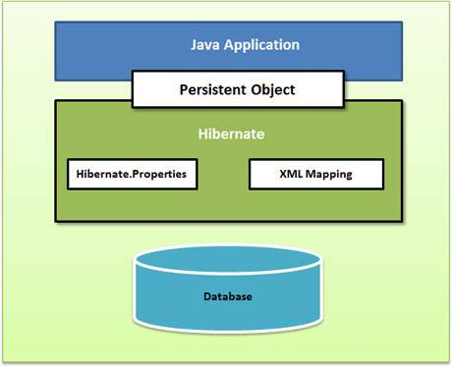
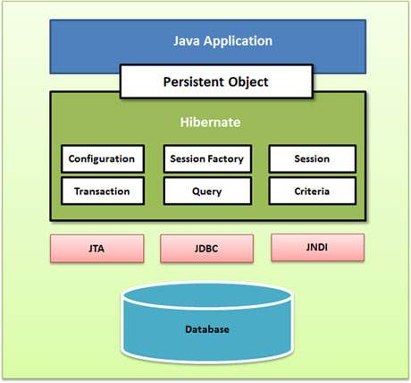
Architecture of hibernate.

Slide 5
Benefits of hibernate
ORM easily solves the data mismatch found between the object oriented classes of an application and relational database.
Transparent Persistence: Hibernates transparent persistence ensures automatic connection between the application’s objects with the database tables.
Database independent: Hibernate is database independent. It can be used to connect with any database like Oracle, MySQL, Sybase and DB2 to name a few.
HQL: Hibernate supports a powerful query language called HQL (Hibernate Query Language). This query language is more powerful than SQL and is completely object oriented.
Dual-layer Caching: Hibernate supports both first level and second level caching mechanisms.
The lazy-loading concept fetches only the necessary object that is required for the execution of an application.

Slide 6
Demerits of JDBC
In jdbc all exceptions are checked exceptions, so we must write code in try, catch and throws.
Jdbc makes the java code to be tightly coupled to Database.
Developer has to write lot of boiler plate code.
Jdbc retrieves the data in table format, in terms of rows and columns not in object format we have to traverse manually.

Slide 7
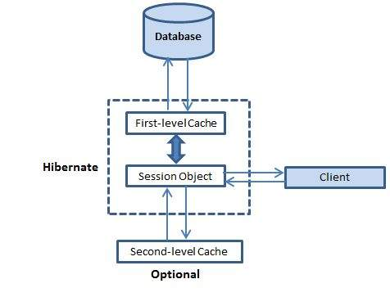
Hibernate caching

Slide 8
Hibernate mapping
One to One Mapping
One to Many Mapping
Many to Many Mapping

Slide 9
Demerits of Hibernate
Debugging: Sometimes debugging and performance tuning becomes difficult.
Slower than JDBC: Hibernate is slower than pure JDBC as it is generating lots of SQL statements in runtime.
Not suitable for Batch processing: It advisable to use pure JDBC for batch processing.
Not suitable for Small projects : For small project having few tables it is useless to work with hibernate.
Generates complex quires with many joins : For complex data, mapping from Object-to-tables and vise versa reduces performance and increases time of conversion

Slide 10
Thank you

